Slide 1
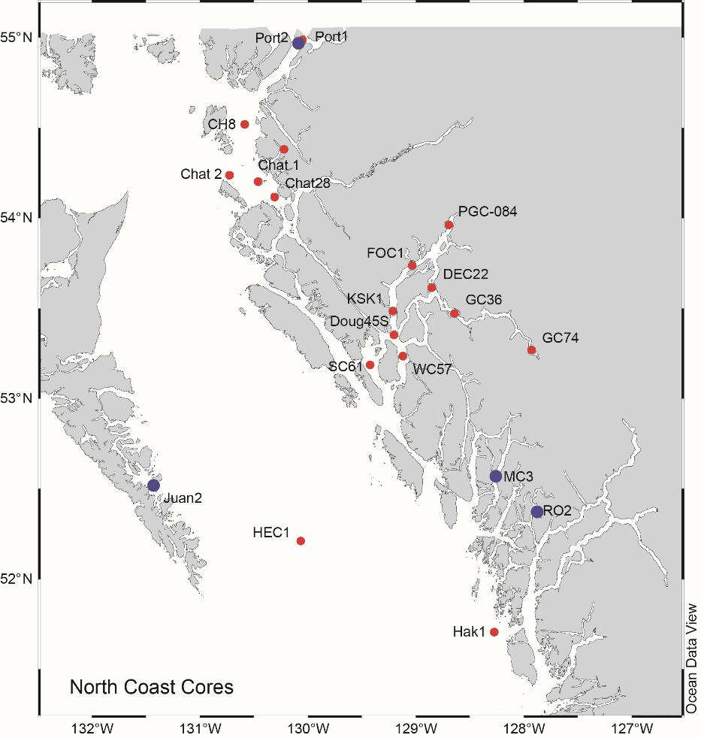
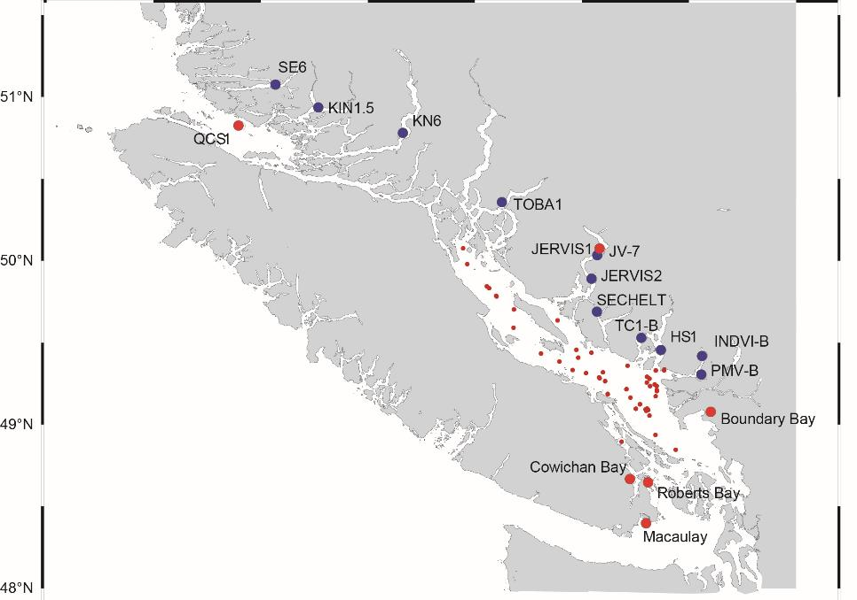
Figure 1. Sediment core location maps. Blue dots: New cores collected in 2022-2025, under PSSI and MCT programs. Red dots indicate existing cores, which will be used to provide context for the new cores.

Slide 2
Marine bloom flux
Marine non-bloom flux
Terrigenous flux
(a)
(b)
Figure 2. Fluxes of marine-bloom, marine-non-bloom and terrigenous organic carbon
in a) Roscoe and b) Knight Inlets. Note that the x-axis scale (carbon flux) for Knight
Inlet is 20 times as high as that for Roscoe Inlet. “Marine” represents mainly
phytoplankton-derived organic matter. “Bloom” represents organic matter produced
under conditions of high productivity, with a short food chain, while “non-bloom”
represents low productivity and a long food chain. The oldest material is at the bottom of the
cores, with time progressing toward the surface. Due to the different sedimentation rates,
the Knight Inlet core represents about 45 years, while the Roscoe core represents about
270 years.

